Slide 1
Comparative abilities of Microsoft Kinect and Vicon 3D motion capture for gait analysis
Alexandra Pfister, Alexandre M. West, Shaw Bronner & Jack Adam Noah

Slide 2
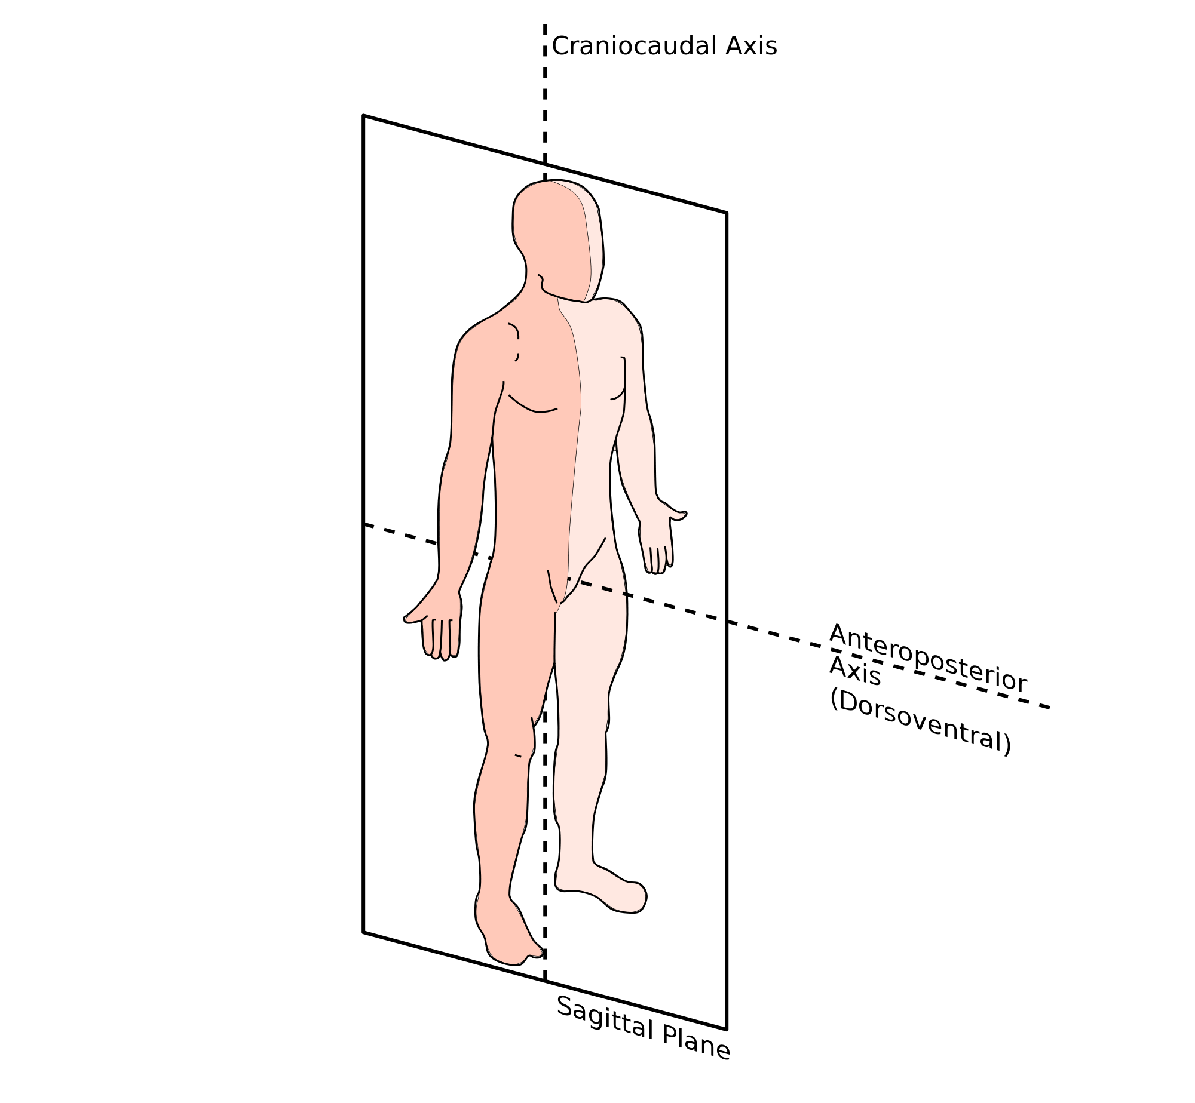
Abstract
Validity of Kinect v1 with Brekel Kinect Software:
for sagittal plane gait kinematics in clinical usage.
in comparsion to Vicon Nexus.
20 Healthy adults (11 male, 9 female) were tracked on a treadmill while jogging and running at three different speeeds.
Measured:
concurrent hip and knee flexion
extension,
stride timing.

Slide 3
Methods
10 Vicon Cameras were placed. (120 Hz.)
excellent instrument reliability [(ICC) (3, k) r = 0.998] and accuracy (SEM = 1.83˚) . (Test lab results)
Kinect was set to 45˚ to the treadmill. (30 – 37 Hz. Unstable)
Subjects took between 10 – 40 steps per leg at three velocities:
3 mph (slow walk)
4.5 mph (brisk walk to slow jog)
5.5 mph (medium to quick jog)

Slide 4
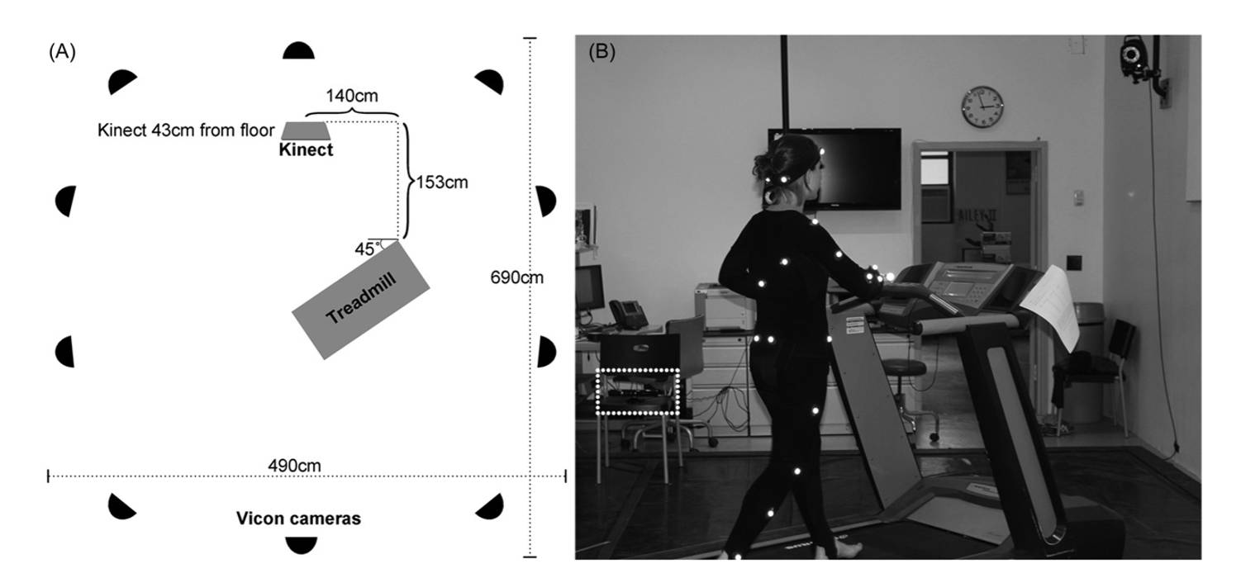

Slide 5
Data Analyses
Outliers were identified using Cook’s D, lever and studentized deleted residual values and removed.
Mean (SD) angular displacement and timing for right and left hip and knee peak flexion and extension were calculated for each subject, at the three velocities.
Separate paired two-tailed t-tests (p < 0.05) were used to compare average Vicon and Kinect peak angular displacement and stride timing among individuals at the three velocities.
In addition, variability of Kinect and Vicon measurements were assessed by SD comparisons across individuals using two-tailed t-tests (p < 0.05).

Slide 6
To determine correlation strength between the Kinect and Vicon system for different measurements, average angular displacement and stride timing at each velocity were separately compared using Pearson product moment correlation coefficients.
Linear regression analyses were performed to calculate the slope (m) of the relationship between Vicon and Kinect measurements. Agreement between Kinect and Vicon measurements was assessed as described by Bland and Altman [21], by determining the mean (SD) difference between paired data points. The Bland Altman mean (SD) difference will be referred to as error.
The percentage of steps missed (%missed steps) by the Kinect system for each subject at each joint was calculated (number missed steps/total number steps). Mean (SD) of %missed steps for the right and left hip and knee were determined and %missed steps between joints and limbs were compared using two-tailed t-tests.
To determine whether the Kinect sensor tracked subjects of a particular size more accurately, %missed steps were compared to three aspects of body size: height, leg length and body ratio (height/leg length). Pearson product-moment correlation coefficient calculations were used to identify linear relationships between %missed steps and size.

Slide 7
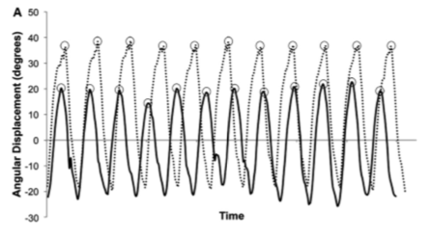
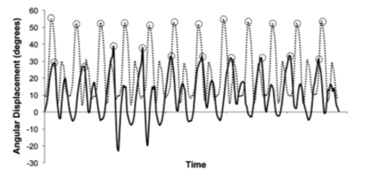
Angular Displacement
Kinect displacements were more variable than Vicon displacement.
Representative gait traces for the left (A) hip and (B) knee at 4.5mph. Kinect gait tracings appear as solid lines and Vicon gait tracings appear as dotted lines. Small circles highlight peak flexion data measured by the Kinect and Vicon. For each subject the average peak flexion from all steps in the trail was compared between Kinect and Vicon.

Slide 8
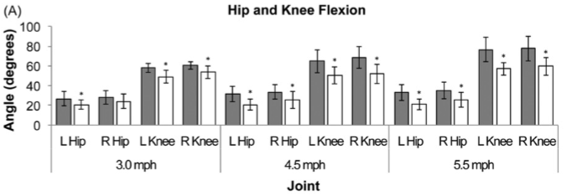
Angular Displacement
Kinect peak flexion angular displacements were smaller than those measured by the Vicon system in every case (p < 0.004), except for the right hip at 3.0mph.

Slide 9
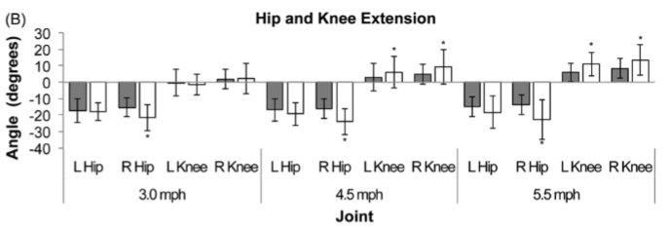
Angular Displacement
Kinect peak extension measurements were consistently greater than that of Vicon.

Slide 10
Angular Displacement
Pearson product moment correlation coefficients (r) were poor (r < 0.30) for hip angular displacement and error was fairly large, greater than 5 ˚, in every case. Linear regression slopes (p > 0.05) were not different from zero in any case for the hip. Correlation strength between Kinect and Vicon knee angular displacements was not consistent for knee data, although high correlations (r > 0.80) were found for right knee flexion and extension at 4.5 and 5.5mph. Error was somewhat smaller for knee data than hip, but values were still generally large.
Positive linear regression slopes (p < 0.05) were found between Kinect and Vicon for all knee data except left knee flexion at 3.0mph; however, the slopes were often far from unity

Slide 11
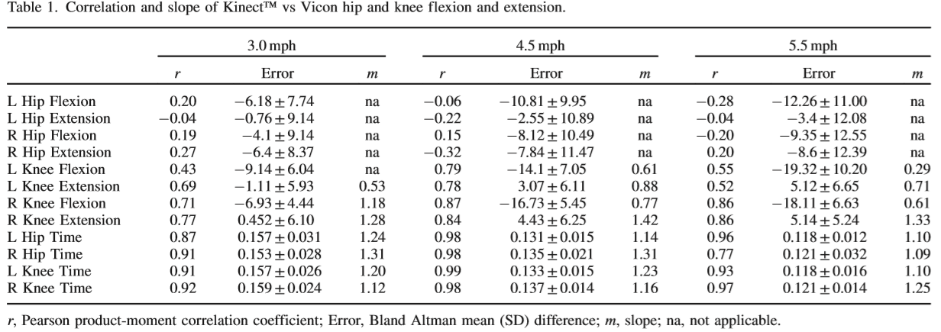

Slide 12
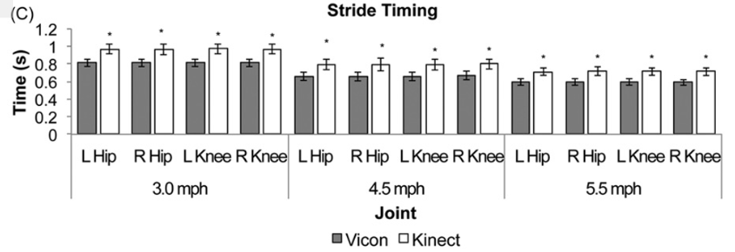
Stride Timing
The Kinect measured longer stride times than Vicon in all cases ( p < 0.02).
Kinect stride timing SD values across individuals were greater than Vicon SD values in every case (p < 0.03), except 3.0mph left hip and 4.5mph right hip.

Slide 13
Stride Timing
Kinect and Vicon stride timing demonstrated high correlations (r >0.80) for both limbs and joints at all velocities in every case except for the right hip at 5.5mph. Error was consistently small and linear regression slopes (p < 0.05) were very close to a value of 1.0 in most cases (Table 1).
On average, the Kinect missed 8–18% of steps and appeared to have difficulty most frequently when the knees crossed. Mean %missed steps did not differ significantly between left and right, hip and knee or between velocities (p > 0.05). Cases of missed steps greater than 30% occurred 16 times out of 240 total trials (6.6%). Correlations between %missed steps and height, leg length or body ratio were poor (r < 0.50).

Slide 14
Discussion
Kinect measurement accuracy was not acceptable for clinical measurement analysis. The Kinect did not produce consistent hip measurements.
Kinect and Vicon knee measurements were better correlated than hip but not consistent enough for clinical application.
Kinect and Vicon stride timing measurements were often well correlated and with some slight adjustments to the software the Kinect may be a clinically acceptable tool to collect temporal gait measurements.

Slide 15
Final Thoughts
The results would be more accurate if the Kinect was placed perpendicular to the subject (e.g. frontal plane).
Due to crossing, 8 – 18% of steps were missed. Multiple Kinects would solve the issue better.
Slower Kinect sampling frequency of 30–37 Hz and insufficient smoothing algorithms may have contributed to Kinect’s inability to properly capture the flexion and extension peak amplitudes.
The Kinect is a remarkable device and, with future improvements, it may become an ideal and affordable tool for clinics and hospitals.

